Slide 1
Cluster Computing, Grid Computing, Parallel Computing Upadhyay Shreyans Indresh Roll No. 18 MSc IT Part 1

Slide 2
Cluster Computing
What is Cluster Computing?
Cluster Computing refers to the process of sharing the computation task
to the multiple computers of the cluster.
The number of computers are connected on a network and they perform a single task by forming a Cluster of computers where the process of computing is called as Cluster Computing.
Cluster Computing is a high performance computing framework which helps in solving more complex operations more efficiently with a faster processing speed and better data integrity. Cluster Computing is a networking technology that performs its operations based on the principle of distributed systems.

Slide 3
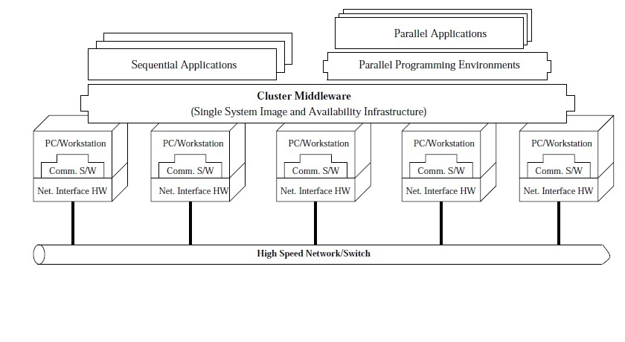
Architecture of Cluster Computing

Slide 4
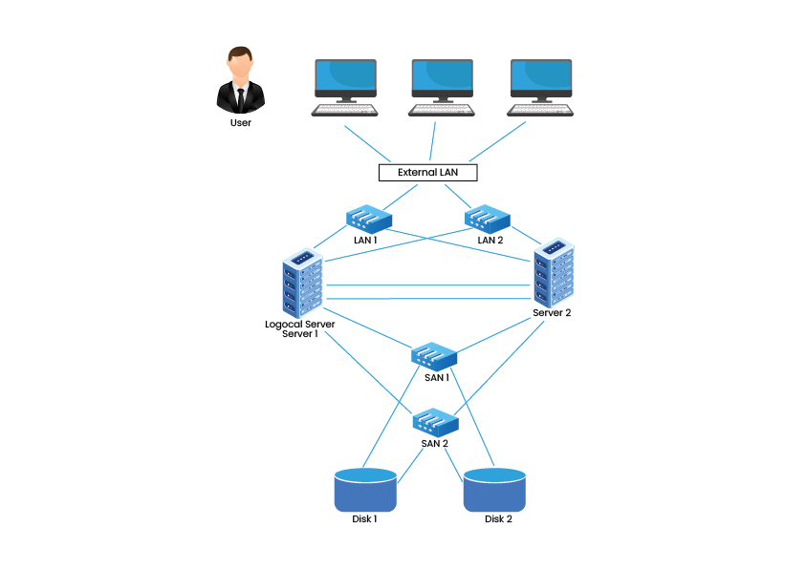
Types of Cluster Computing
High Availability Cluster
These cluster models create availability
of services and resources in an uninterrupted
method using the system’s implicit redundancy.
The basic idea in this form of Cluster is that if a
node fails, then applications and services can be
made available to other nodes.
These types of Clusters serve as the base for
critical missions, mails, files, and application servers.

Slide 5
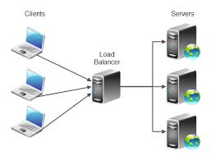
2. Load Balancing Cluster
Load Balancing is a computer networking
methodology to distribute workload across
multiple computers or a computer cluster.
Load-balancing cluster operate by routing
all work through one or more load-balancing
front-end node, which then distribute the
workload efficiently between the remaining
active nodes.
Load balancing clusters are useful for those
who are working with limited IT budgets.

Slide 6
3. High-Performance Cluster
An HPC cluster is a collection of many separate servers (computers), called nodes, which are connected via a fast interconnect.
High-performance computing (HPC) is the ability to process data and perform complex calculations at high speeds.
One of the best-known types of HPC solutions is the supercomputer. A supercomputer contains thousands of compute nodes that work together to complete one or more tasks.
This is called parallel processing. It’s similar to having thousands of PCs networked together, combining compute power to complete tasks faster.
HPC solutions have three main components:
Compute
Network
Storage

Slide 7
Advantages and disadvantages of Cluster Computing
Processing speed is high as that of mainframe computer and super computer.
Extended resource availability to eliminate breakdown.
Scalable
Flexible
Cost is high since cluster needs good hardware and a design, it will be costlier to a non-clustering server management design.
Since clustering needs more servers and hardware to establish one, monitoring and maintenance is hard. Thus increase the infrastructure

Slide 8
Grid Computing
Grid Computing can be defined as a network of computers working together to perform a task that would rather be difficult for a single machine.
All machines on that network work under the same protocol to act like a virtual supercomputer.
The task that they work on may include analyzing huge datasets or simulating situations which require high computing power.
Computers on the network contribute resources like processing power and storage capacity to the network.
Working of Grid Computing
Control Node
A computer, usually a server or a group of servers which administrates the whole network and keeps the account of the resources in the network pool.
Provider
The computer which contributes it’s resources in the network resource pool.
User
The computer that uses the resources on the network.

Slide 9
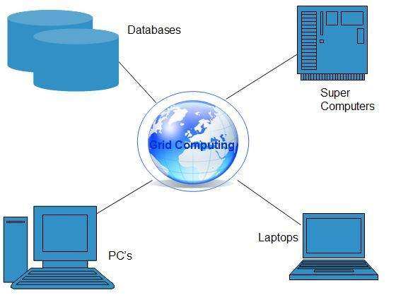
Grid Computing Architecture
It can be defined as the network of computers working together to perform a task that would rather be difficult for a single machine.

Slide 10
Types of Grid Computing
There are many types of grid like:-
1) COMPUTATIONAL GRID:- It acts as the resource of many computers in a network to a single problem at a time.
2) DATA GRID:- It deals with the controlled sharing and management of distributed data of large amount.
3) COLLABORATIVE GRID:- It is the grid which solves collaborative problems.
4) MANUSCRIPT GRID:- This grid works well when things are presenting in large continuous blocks of text or images.
5) MODULAR GRID:- This grid works well when columns alone don’t offer enough flexibility for complex problems.

Slide 11
Role of Grid Computing organization
Based on their functional role they are
Organizations developing grid standards and practices for guidelines.
It acts as middleware solutions
It is a based solution which can solve computing, data and network requirements.
It adopts grid concept for commercial purpose
Grid Activities
Grid shares many different kinds of resources which is transparent to the end user.
It can solve many number of problems occurred in both science and industry.

Slide 12
Parallel Computing
What is Parallel Computing?
Processing of multiple tasks simultaneously on multiple processors is called parallel computing.
The parallel program consists of multiple active processes simultaneously solving a given problem. A given task is divided into multiple subtasks using a divide-and-conquer technique, and each subtask is processed on a different central processing unit (CPU).
Programming on a multiprocessor system using the divide-and-conquer technique is called parallel programming.

Slide 13
The development of parallel processing is being influenced by many factors. The prominent among them include the following:
Computational requirements are ever increasing in the areas of both scientific and business computing. The technical computing problems, which require high-speed computational power, are related to life sciences, aerospace, geographical information systems, mechanical design and analysis.
Sequential architectures are reaching physical limitations as they are constrained by the speed of light and thermodynamics laws. The speed at which sequential CPUs can operate is reaching saturation point and hence an alternative way to get high computational speed is to connect multiple CPUs (opportunity for horizontal growth).
Hardware improvements in pipelining, superscalar, and the like are nonscalable and require sophisticated compiler technology. Developing such compiler technology is a difficult task.
Vector processing works well for certain kinds of problems. It is suitable mostly for scientific problems (involving lots of matrix operations) and graphical processing. It is not useful for other areas, such as databases.

Slide 14
Hardware architectures for parallel processing
The core elements of parallel processing are CPUs. Based on the number of instruction and data streams that can be processed simultaneously, computing systems are classified into the following four categories:
Single-instruction, single-data (SISD) systems
Single-instruction, multiple-data (SIMD) systems
Multiple-instruction, single-data (MISD) systems
Multiple-instruction, multiple-data (MIMD) systems
1. Single –instruction, single-data (SISD) systems
An SISD computing system is a uniprocessor machine capable of executing a single instruction, which operates on a single data stream. . In SISD, machine instructions are processed sequentially; hence computers adopting this model are popularly called sequential computers.
2. Single-instruction, multiple-data (SIMD) systems
An SIMD computing system is a multiprocessor machine capable of executing the same instruction on all the CPUs but operating on different data streams. Machines based on an SIMD model are well suited to scientific computing since they involve lots of vector and matrix operations.

Slide 15
3. Multiple-instruction, single-data (MISD) systems
An MISD computing system is a multiprocessor machine capable of executing different instructions on different PEs but all of them operating on the same data set. For instance, statements such as
4. Multiple-instruction, multiple-data (MIMD) systems
An MIMD computing system is a multiprocessor machine capable of executing multiple instructions on multiple data sets. Each PE in the MIMD model has separate instruction and data streams; hence machines built using this model are well suited to any kind of application. Unlike SIMD and MISD machines, PEs in MIMD machines work asynchronously.
Approaches to Parallel Computing
A sequential program is one that runs on a single processor and has a single line of control. A wide variety of parallel programming approaches are available. The most prominent among them are the following:
Data Parallelism
Process Parallelism
Farmer and worker model

Slide 16
Application of Parallel Computing
This technique is used in application requiring processing of large amount of data in
Sophisticated way. For example:
Databases, Data Mining.
Networked videos and multimedia technologies.
Medical imaging and diagnosis.
Advanced graphics and virtual reality.
Collaborative work environments

Slide 17
Thank You

